Slide 1
Exponential Growth
How fast things grow

Slide 2
Exponents in the real world
We use exponents to make predictions that can save lives.
Radio active decay
Genetics
Computer viruses
Disease epidemic rates
ETC…

Slide 3
"The CyberSquad tries to escape from a deserted island where Hacker has stranded them. They have been told that a particular tree will help them escape. They find one lily pad and wonder how they can use the lily pads to reach the nearest island, which is 128 lily pads away."

Slide 4
Predicting a Computer Virus
A computer analyst looks at her computer at 1 p.m. and sees 4 MB of lost memory. At 2 o'clock, she notices 3 times as much memory has been lost.
She realizes that she has a serious virus in the computer and that if the amount of memory lost exceeds 26,242 MB, her system will crash. How many hours does she have before her computer crashes? Justify your answer using your answer using a table and a line graph.
Time | Lost memory
1:00 | 4 MB

Slide 5
How to play: Each group is given a set of problems to evaluate.
When your is done evaluating, you have to find the color or the
Number that has the same answers as you. When you find that group
You will color in the heart with according to your number.
GROUP 1 Problems Numbered 1-3 | GROUP 2 Problems Numbered 4-6 | GROUP 3 Problems Numbered 7-9
COLORS Orange Purple L. Blue | COLORS Pink L.Green Brown | COLORS Drk. Blue Yellow Red

Slide 6
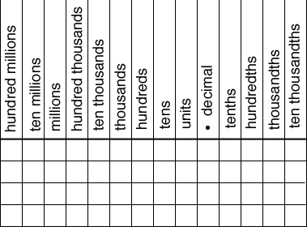
Understanding Magnitude
Scientific notation is used to express very large or very small numbers.
For example, there are approximately 6,000,000,000 humans on earth. This number could be written in scientific notation as 6x${10}^{9}$. The number 6,000,000,000 is equivalent to 6*1,000,000,000. The number 1,000,000,000 is equivalent to 109 or 10*10*10*10*10*10*10*10*10.
So with Scientific notation, you are growing
Or decreasing by one or more place values.
REMEMBER PLACE VALUE??

Slide 7
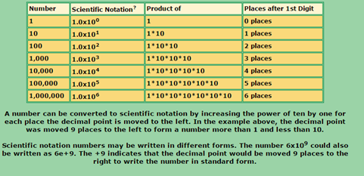

Slide 9
YEAH….BUT HOW MUCH IS IT WORTH?
Move the decimal point to the right for positive exponents of 10.
Move the decimal point to the left for negative exponents of 10.
The exponent tells you how many places to move.

Slide 10
Adding and Subtracting w/Scientific Notation
Rewrite the problem so that the notations are the same power.
Use the associative and commutative property as necessary to combine like terms. (“factoring out”)
Ensure that your final answer is in scientific notation (meets the requirements).

